Slide 1
Dawn Blossoms Plucked at Dusk
Block2-RBC Membrane Shape Simulation
Junru Jin
2023.5.17

Slide 2
Outline
1. Basic introduction
2. Code results
3. Github trails

Slide 3
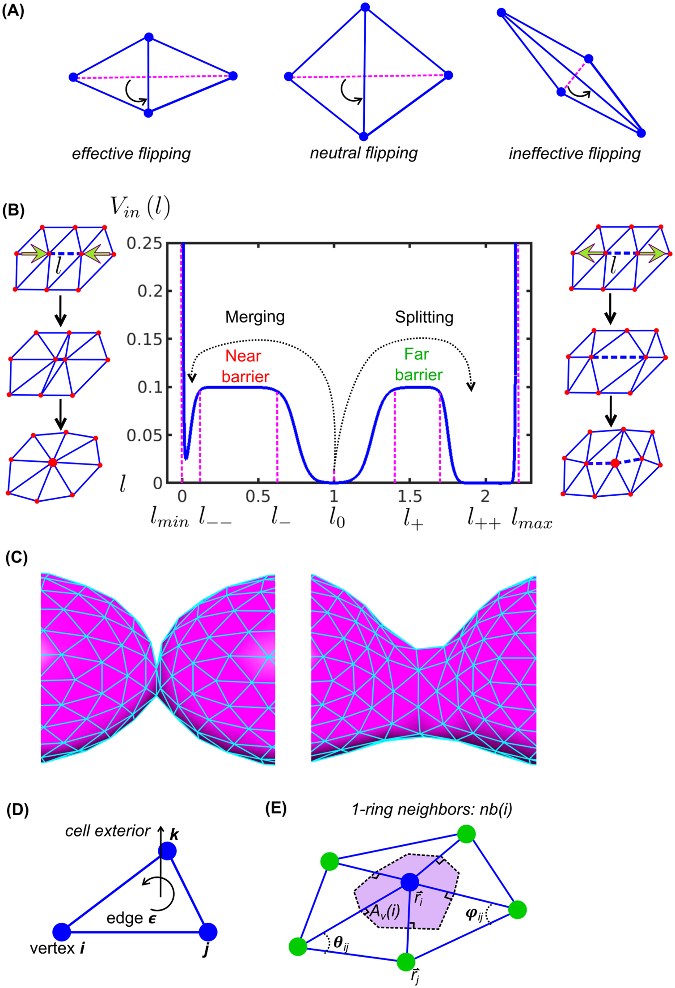
Background introduction
Problem: Developing membrane models to study cell morphodynamics requires a sampling of the total free energy in a discretized representation of the free form surface.
Idea: Implement a flexible meshing of a cell surface in a free energy-dependent model of the membrane.
The dynamics of the vertices follow the minimization of the total free energy in the membrane system
Xinxin Wang et al. Remeshing flexible membranes under the control of free energy. PLOS Computational Biology. 2022

Slide 4


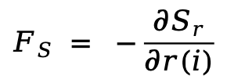

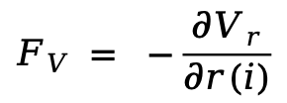
Background introduction
We have different energy and force to simulate the results.
Here, we use Internal force, Helfrich energy force, volume energy force and surface energgy force.
$$E_{V }= k_{v}\frac{{\left(V−V_{0}\right)}^{2}}{V_{0}}$$
$$F_{V }= −\frac{{∂V}_{r}}{∂r(i)}$$
volume energy force:
$$E_{S }= k_{s}\frac{{\left(S−S_{0}\right)}^{2}}{S_{0}}$$
$$F_{S} = −\frac{{∂S}_{r}}{∂r(i)}$$
surface energy force:
Total force:
$$F_{total }= F_{I }{+ F}_{H }{+ F}_{S }{+ F}_{V }$$
Xinxin Wang et al. Remeshing flexible membranes under the control of free energy. PLOS Computational Biology. 2022

Slide 5
Background introduction
Persudo code of core part:
for i = 1:length(m.var.coord)
for dim = 1:3
% Perturb positively
m.var.coord(i, dim) = r_orig + epsilon;
Ev_before = kv * (Volume(m)) - targetVolume)^2 / targetVolume);
Es_before = ks * (Area(m)) - targetVolume)^2 / targetVolume);
Hp = Helfrich(m_update); % Compute Helfrich free energy
% Perturb negatively
m.var.coord(i, dim) = r_orig - epsilon;
Ev_after = kv * (Volume(m)) - targetVolume)^2 / targetVolume);
Es_after = ks * (Area(m)) - targetSurfaceArea)^2 / targetSurfaceArea);
Hm = Helfrich(m_update); % Compute Helfrich free energy
% Finite difference approximation of the gradient
Fb(i, dim) = -(sum(Hp) - sum(Hm)) / (2 * epsilon);
Fv(i, dim) = -(Ev_before - Ev_after) / (2 * epsilon);
Fs(i, dim) = -(Es_before - Es_after) / (2 * epsilon);
end
end

Slide 6
Background introduction
Persudo code of whole part:
% Initialize the m
m = ModMembrane(2, 'unit', u);
% compute Internal force
Fi = Finternal(m);
for iter = 1:n_iter:
% compute other forces
get Fb, Fv, Fs
% smooth forces
Fb, Fv, Fs = smoothForces(Fb, Fv, Fs, m);
% get the adaptive time step
dt, Ftotal, l = varDt(m, Fi, Fb+ Fv+ Fs, mu);
% update coord
m.var.coord = m.var.coord + m.pm.mu * Ftotal * dt;
% remesh the m
m = Remesh(m)

Slide 7
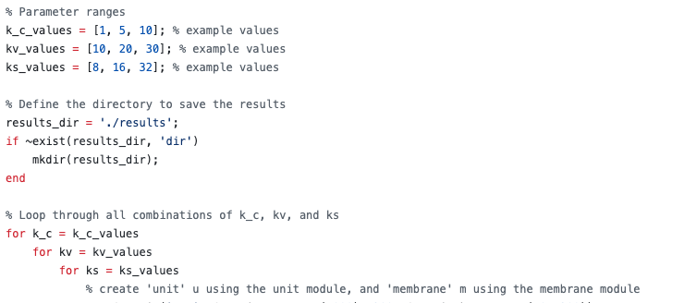
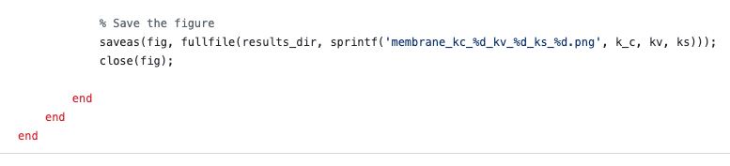
Code results
Because different parametrs will influence the final reuslts and it is important to know which is the good parameters to make it work.To find a best paprameters of ks, kv, kb, we use grid search.
Define search space
Use loop to do grid search

Slide 8
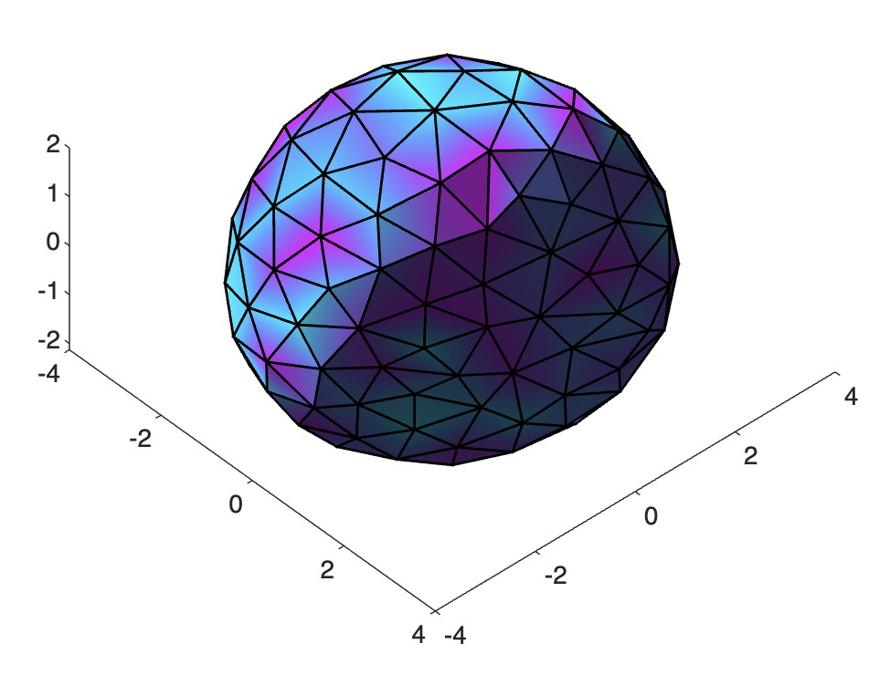
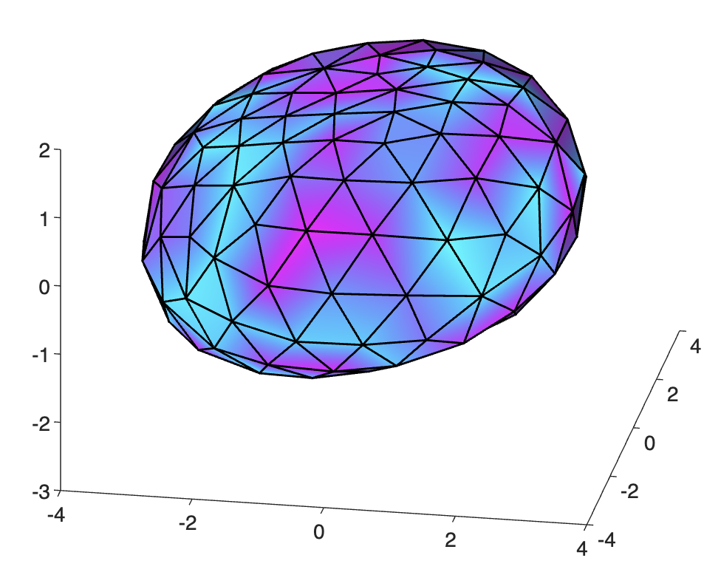
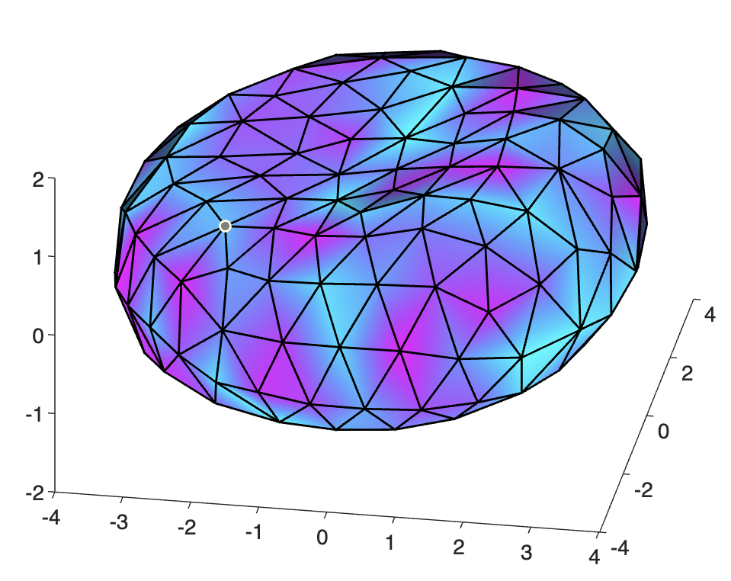
Code results
Final parameters we use is kc=5, kv=20, ks=16.
The iterative process is shown in the figure below:
iteration = 20
iteration = 500
iteration = 1500

Slide 9
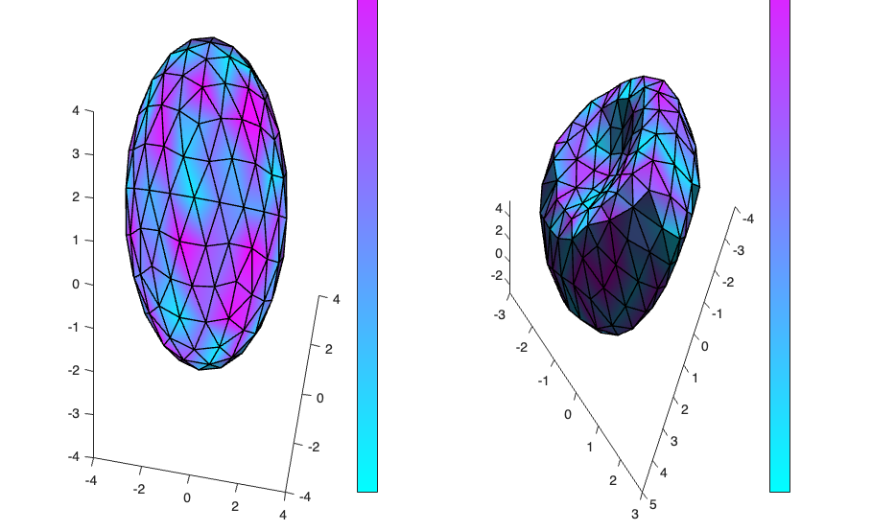
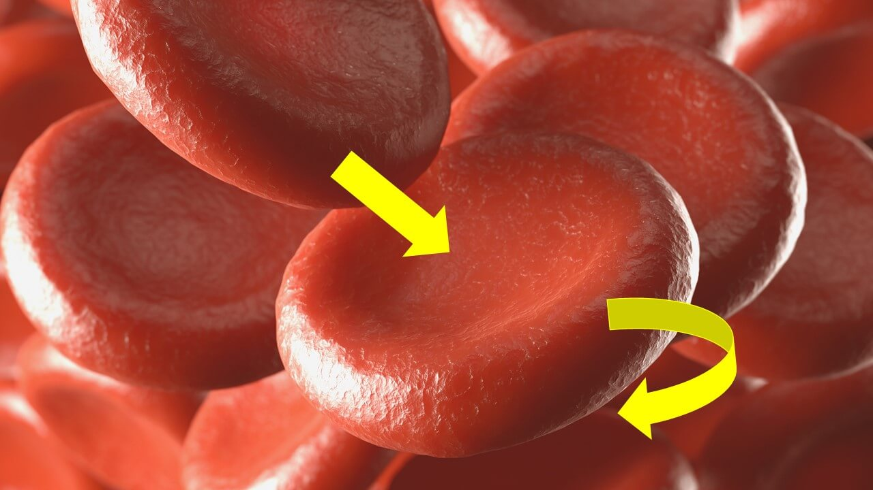
Code results
A direct comparison between original m and final m.
The Structure of Red Blood Cells

Slide 10
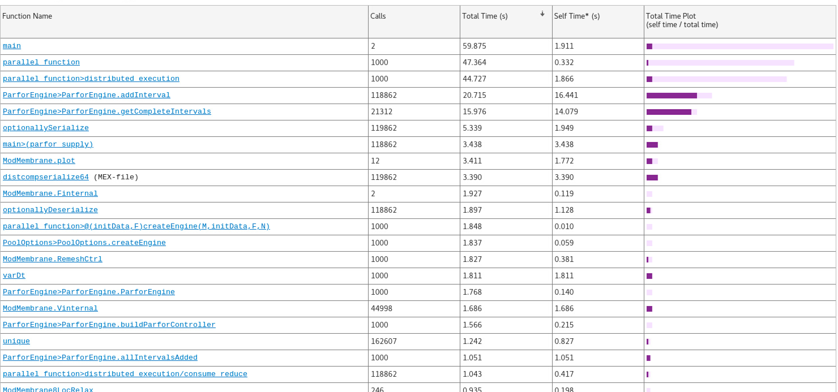
Code results
Matlab Profile helps identify performance bottlenecks, especially those functions with high self times, which may be worth optimizing to improve overall performance.
To make the loop run faster, we use parfor to perform the loop, which utilizes multiple processes.

Slide 11
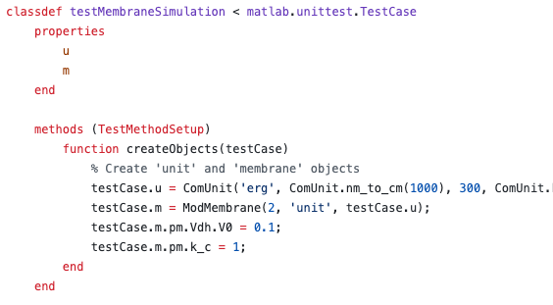
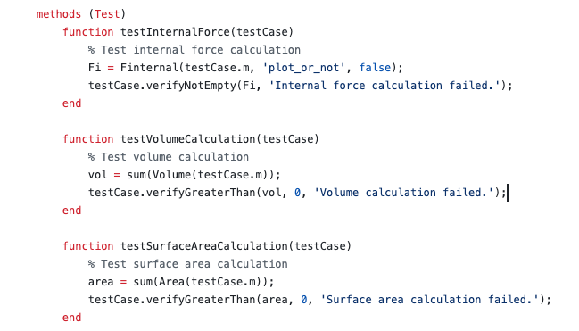
Code results
To do unit test and regression test, we construct a Test class to make sure every update harmless.

Slide 12
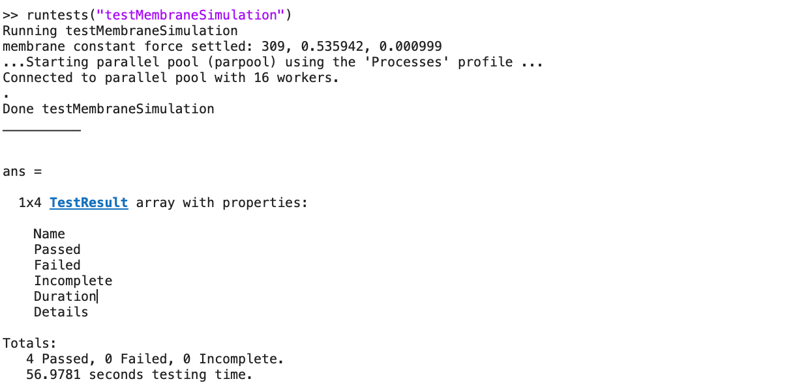
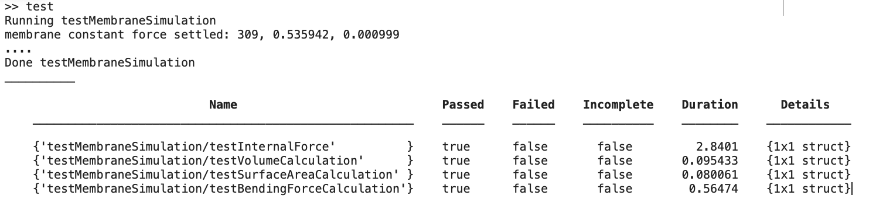
Code results
The test code results log, all code pass

Slide 13
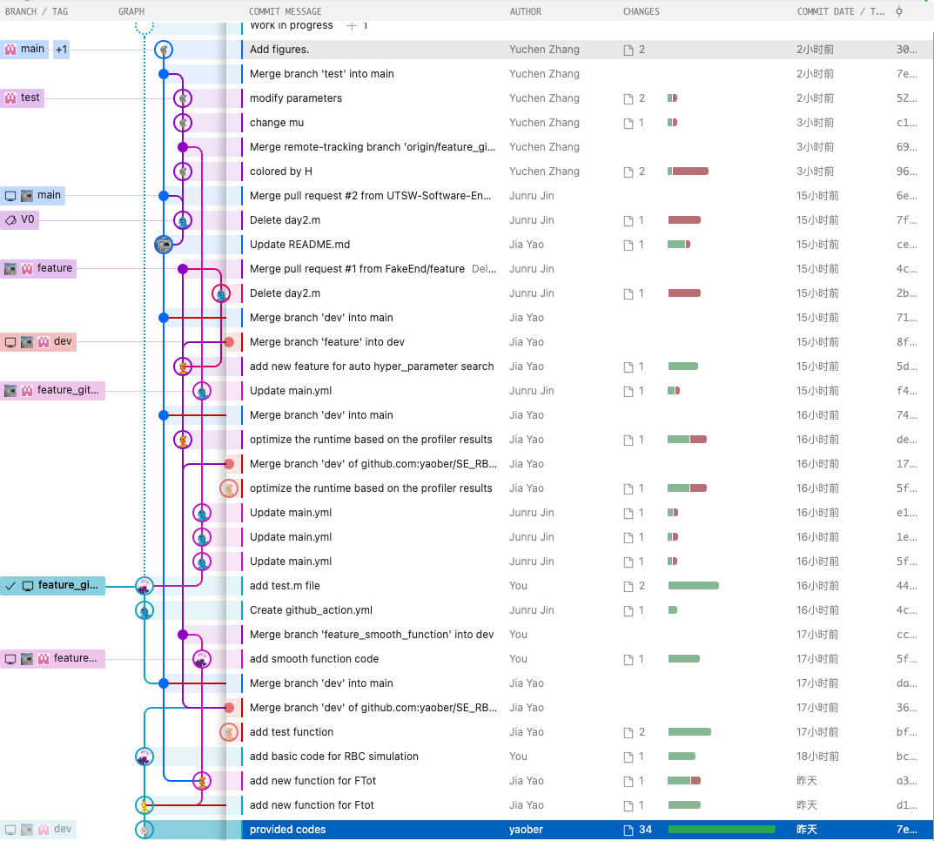
Github trails
We work as a team, so it is important to use github to do collabration.
Different branches:
-Main: the branch publish code and package
-dev: development enviorment
-feature: develop different feature
-feature_faster: use parfpor to evaluate the code
-feature_git_action: add git action to do test
......

Slide 14
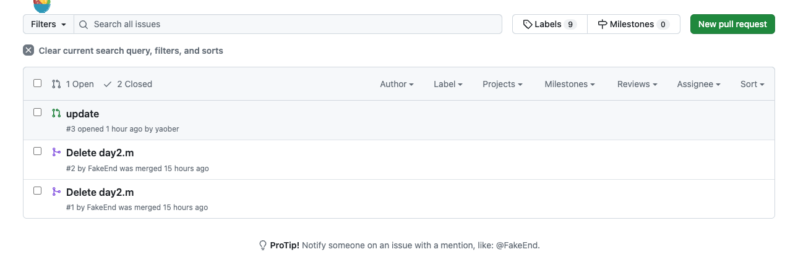
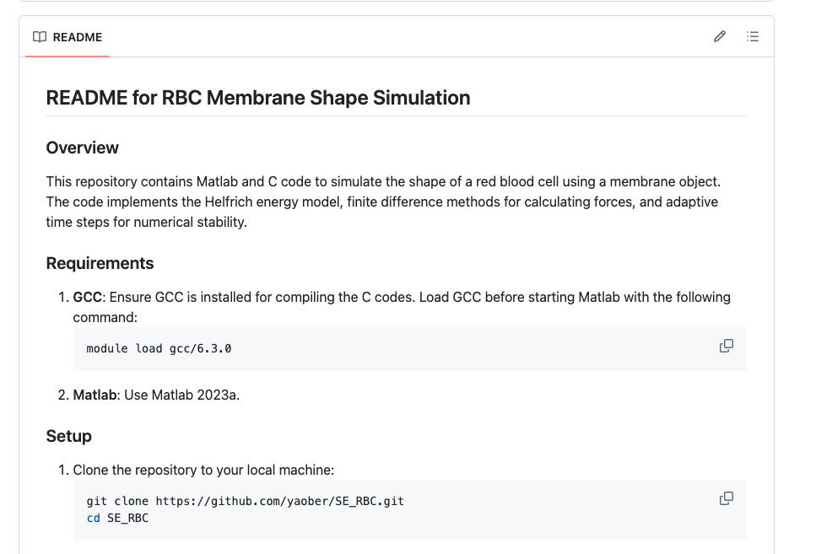
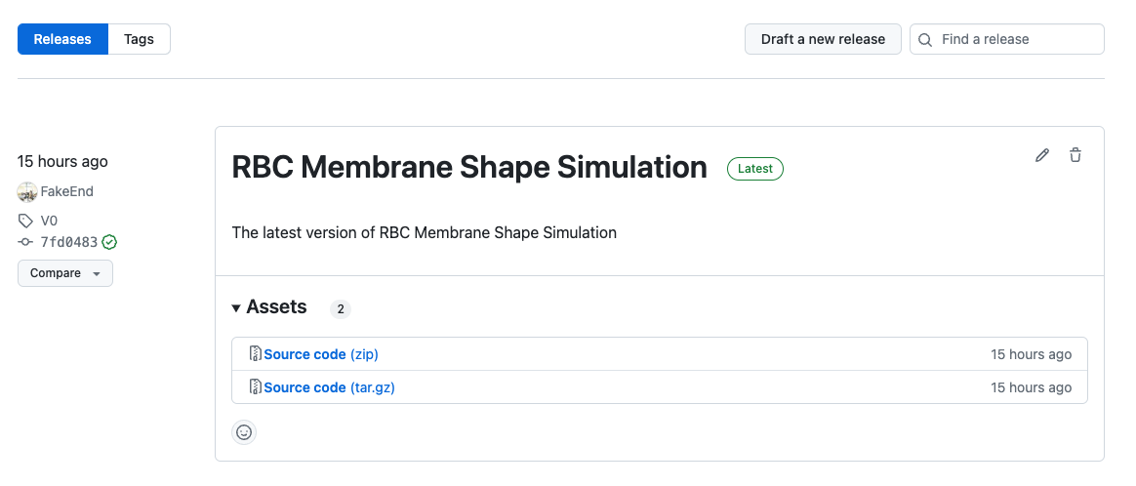
Github trails
We also uses different tools in github, for example ReadME, pull request and release code:

Slide 15
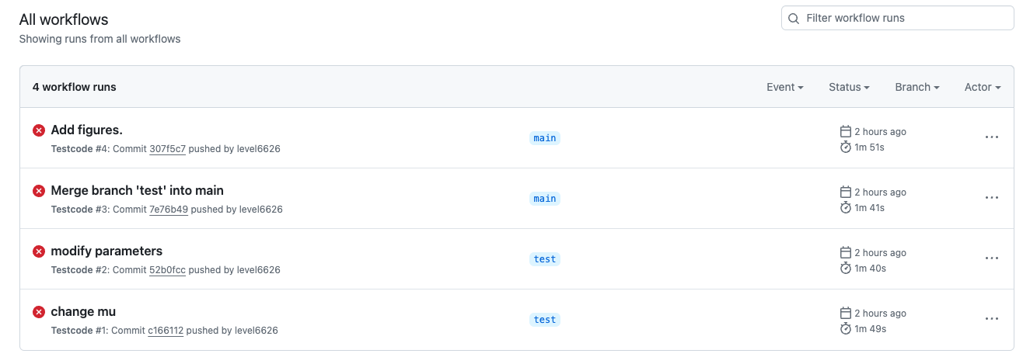
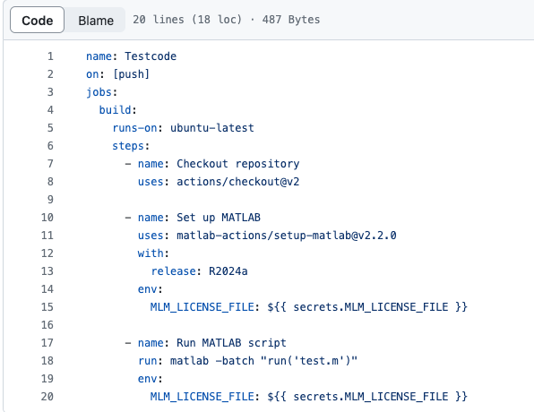
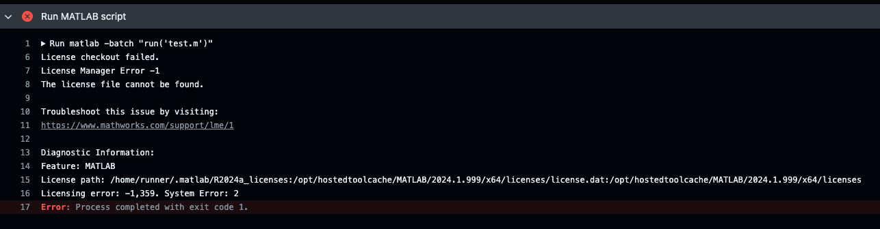
Github trails
Fail on github action code:

Slide 16
Thanks for listening

